Slide 1
Traffic Modelling System
Team: Ekathra
By:
Ashwini Cherukuri
Rupanandha Moori
Sahil Nokhwal
Rama Naveen Kommuri
Laxmi Sai Teja Naraharasetty
Vamsi Chowdary Bobba
Manikanta Nomula

Slide 2

Client and Mentor
Client & Mentor: Dr. Michael Oudshoorn
Associate professor in the School of Computer Science and Information System

Slide 3
Outline
Project Overview
Requirements
Project management plan
Challenges faced
Tools and Technologies
Use cases
Prototypes
Conclusion

Slide 4
Project Overview
Nowadays traffic is a main problem. This is caused due to different reasons.
One of the reasons may be deploying the wrong setup of roads.
So making a traffic study and choosing the correct type of road at a particular situation will help to reduce the traffic issues.

Slide 5
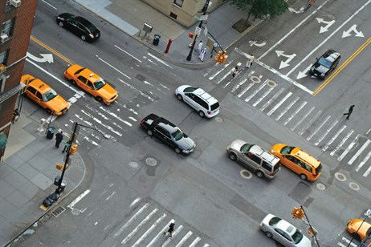
Project Overview (Contd..)
One of the basic goals of studying traffic is to understand traffic congestion and look for ways to prevent it.
The goal is to provide efficient movement of traffic while minimizing congestion problems.

Slide 6
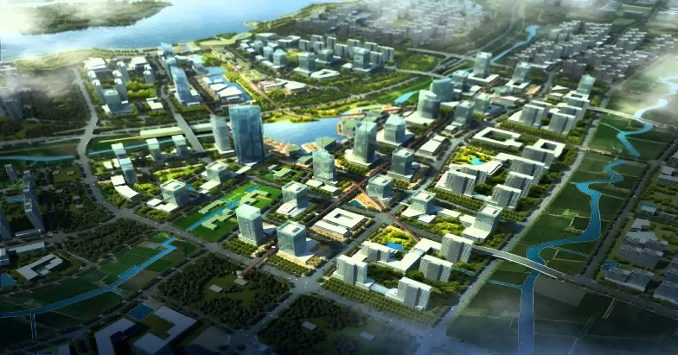
Project Overview (Contd..)
Developing a traffic modelling system can also be used in city planning.
It also help to improve environment by preventing unwanted traffic which will reduce both release of CO2 and chances of vehicle collision
A model of city planning

Slide 7
Requirements
User should be able to drag and drop different types of roads which include 2-ways, 4-ways, roundabouts, traffic signals and T-junction.
Should able to connect them and if require then edit the sequence
Load the default values from file
If required, user can change default values
The user should provide the below details regarding
Arrival rate.
Speed limit of the road, which will be a range. Ex- 60-65 mph.
Distance of the roads.
Distance between the vehicles.

Slide 8
Requirements (Contd..)
Every direction has some percentage distribution among total incoming vehicles
The roads should be one-way.
Hardware requirements: 2 GB RAM (Microsoft recommendation)
The cars should maintain some threshold distance among them.
The cars should come in all directions and in different speeds.
The cars must avoid accidents.
Car should destroy after reaching end point
Display the simulated result

Slide 9
Project Management Plan
Project Scope:
It involves integration of different types of roads to simulate the behavior of the traffic.
Project Deliverables :
Consists of working web based application meeting the specifications and functionality required by the client.
Project Organization:
a. Organizational Structure:
Implementing a functional structure where everyone would be reporting to their supervisor respectively.
b. Organizational boundaries and interfaces:
Each task is assigned to a team member in the team as their responsibility.

Slide 10
Project Management Plan
Project Responsibilities:
Each and every deliverable of the project must be developed meeting all the constraints related to the project.
Budget Allocation:
For each person
Weekdays: 5X2=10
Weekend team meetings: 2X2=4
Client Meeting: 1X1=1
Total: 15 Hours

Slide 11
Project Management Plan:
We are spending about 15 hours per person per week which makes a total of 85hours per week per team.
The total budget of the project is 85X24 = 2040.
Per week per person: 15X1 = 15
Per week per team: 15X7 = 85
Total hours per team: 85X26 = 2210 hours.
26 weeks is the total number of weeks the project is going to take.

Slide 12
Challenges faced
Team Jelling.
Software Challenges.
Planning and Integration.

Slide 13
Tools and Technologies
Eclipse
GitHub
Java
Swing
HTML5
Tomcat
Chrome

Slide 14
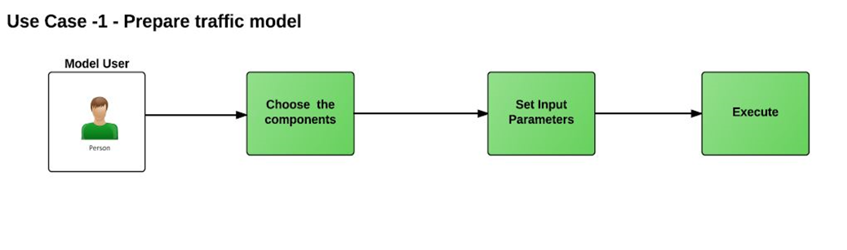
Use Cases

Slide 15
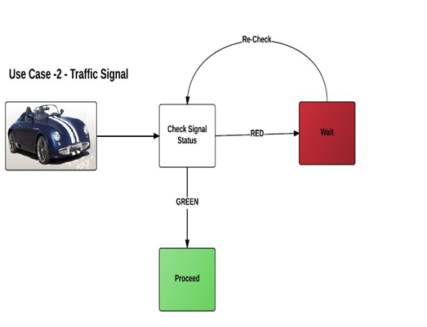
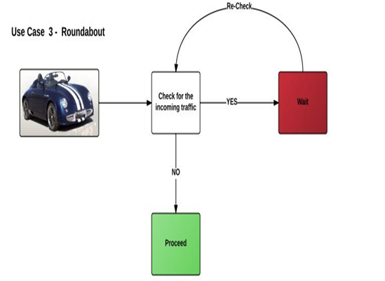
Use Cases (Contd..)

Slide 16
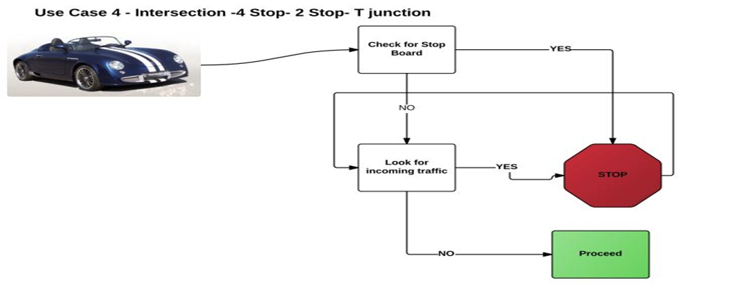
Use Cases (Contd..)

Slide 17
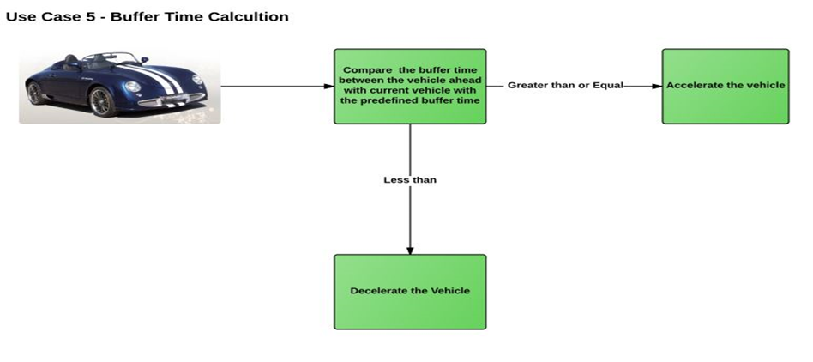
Use Cases (Contd..)

Slide 18
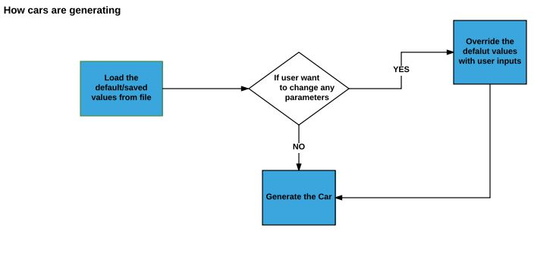
Use Cases (Contd..)

Slide 19
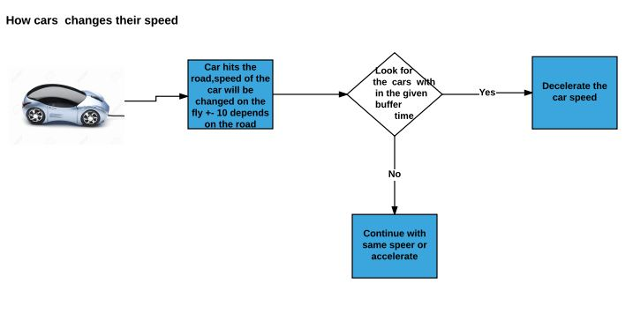
Use Cases (Contd..)

Slide 20
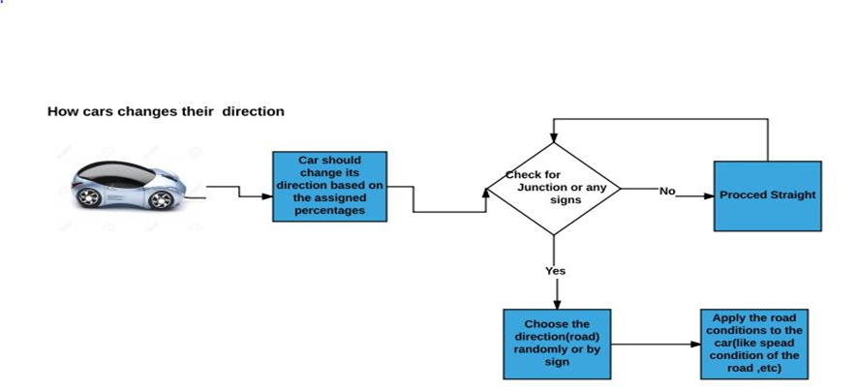
Use Cases (Contd..)

Slide 21
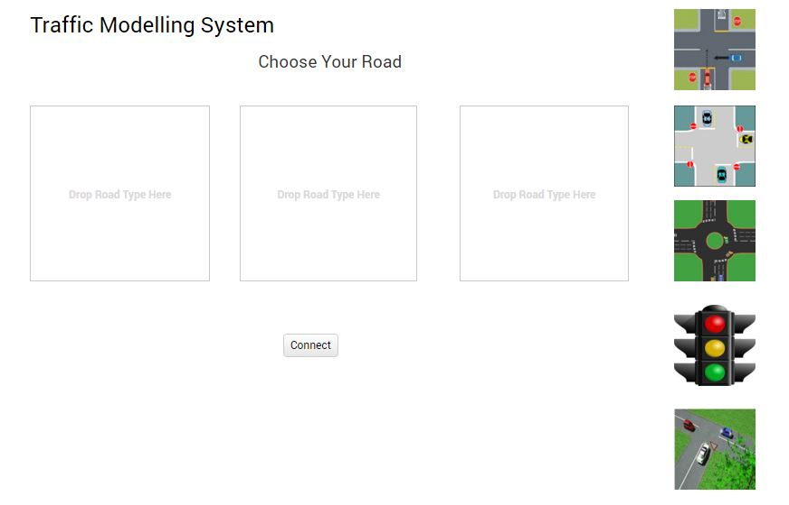
Prototypes
The user can simulate different scenarios by choosing different roads.
He just need to drag different roads into the boxes shown.
He will press “Connect” button and then the simulation starts.

Slide 22
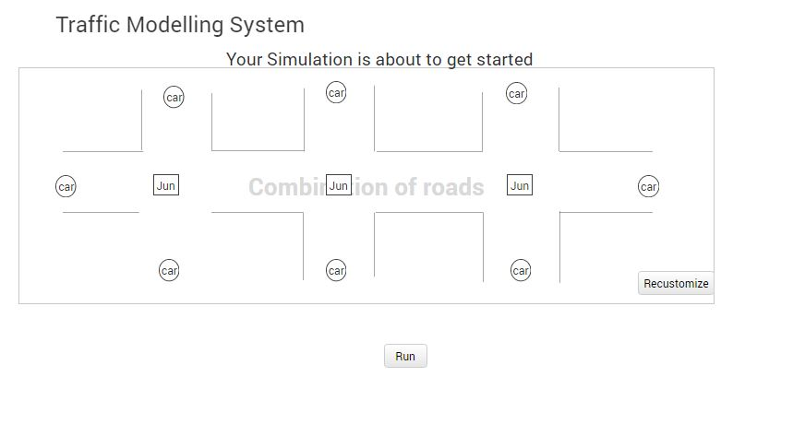
Prototypes(Contd..)
After the user select the roads, before stimulation the user must use car generators at every entry of the road system

Slide 23
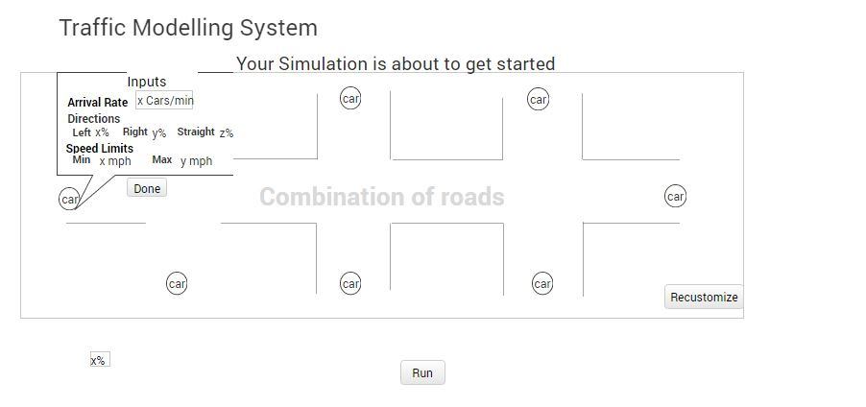
Prototypes(Contd..)
The user can check the input values and also can re-customize the roads. He can click run to start the stimulation.

Slide 24
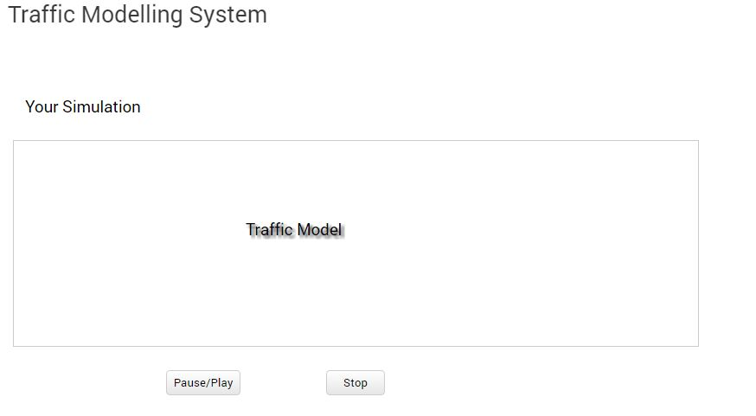
Prototypes(Contd..)
The user can pause or stop the stimulation at any point of time.

Slide 25
Conclusion
Completed requirement document
Need approval from client
If any change, then update it and submit
Be ready to start coding.

Slide 26

Any Queries?

Slide 27

Thank You!

